Slide 1
Training and Testing Bias and Variance
Lei Qian, Ph.D. Fisk University

Slide 2
Working flow for a machine learning project
Collect Data
Label Data (supervised learning)
Preprocessing Data
Train Model
Test Model
Finish
Improve Model

Slide 3
Training and Testing
The data that is used for training models is called training data. The data that is used to test the model is called test data.
Usually we split all samples into two disjoint sets: training dataset and test dataset.
One important rule is that there cannot be any intersection between the training dataset and the testing dataset. Also, when the sample dataset is split into training and test sets, it is important that each type of data samples should be evenly distributed in both training and test sets.

Slide 4
Underfitting and Overfitting
The bias is an error from erroneous assumptions in the learning algorithm.
The variance is an error from sensitivity to small fluctuations in the training set.
Underfitting occurs when a model cannot adequately capture the underlying structure of the data. Underfitting occurs if the model or algorithm shows low variance but high bias. It is often a result of an excessively simple model or uses too few features.
Overfitting, also called high variance, is caused by a model that fits the available data but does not generalize well to predict new data. It is usually caused by over complicate functions that model the random noise in the training data, rather than the intended outputs.

Slide 5
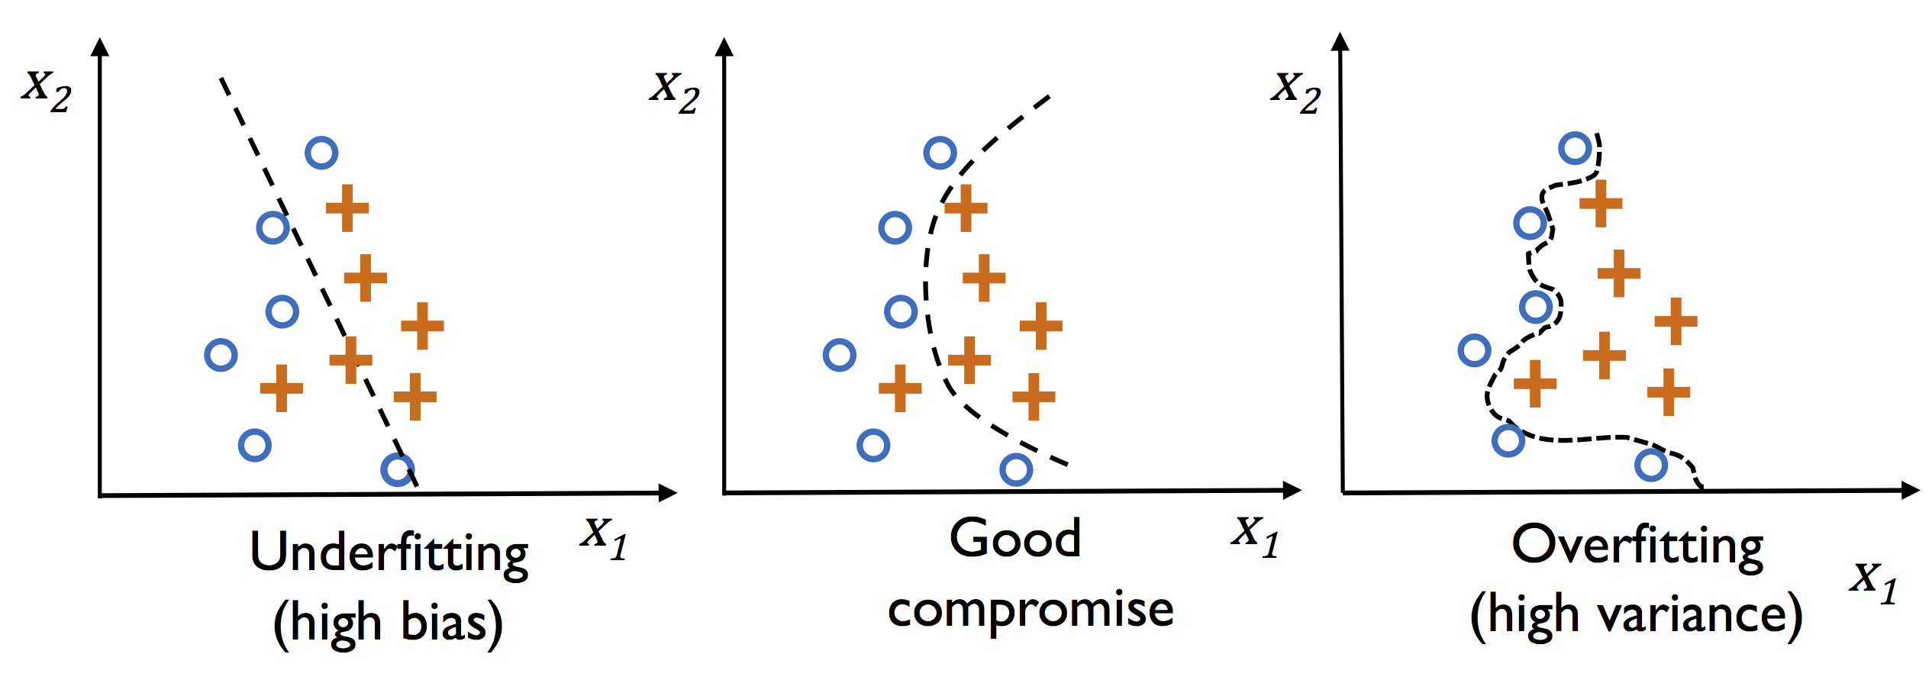
Underfitting and Overfitting

Slide 6
Identify Underfitting and Overfitting
Underfitting: Performance of the model on both training and test data are bad.
Overfitting: Performance of the model on training data is significantly better than on test data.
For example, if the model get 70% accuracy for the training set and 67% for the test set, it is an indication of underfitting, or high bias.
If the model get 95% accuracy for the training set and 85% for the test set, it is likely to have overfitting, or high variance.
If the model get 92% for the training set and 90% for the test set, it is about right. Even though there is still room to be improved.

Slide 7
The bias-variance tradeoff
The bias-variance tradeoff is a central problem in supervised learning.
Typically, if the model is too simple, we have high bias (underfitting)
If the model is too complicate, we may have high variance problem (overfitting).

Slide 8
Training and Test data
The goal of the machine learning is to find the model that give the best results for real world problems.
Just because a learning algorithm fits a training set well, that does not mean it is a good model.
We can use test data to simulate the real world and use the performance of a model in test data to measure the potential performance of the model in real world.

Slide 9
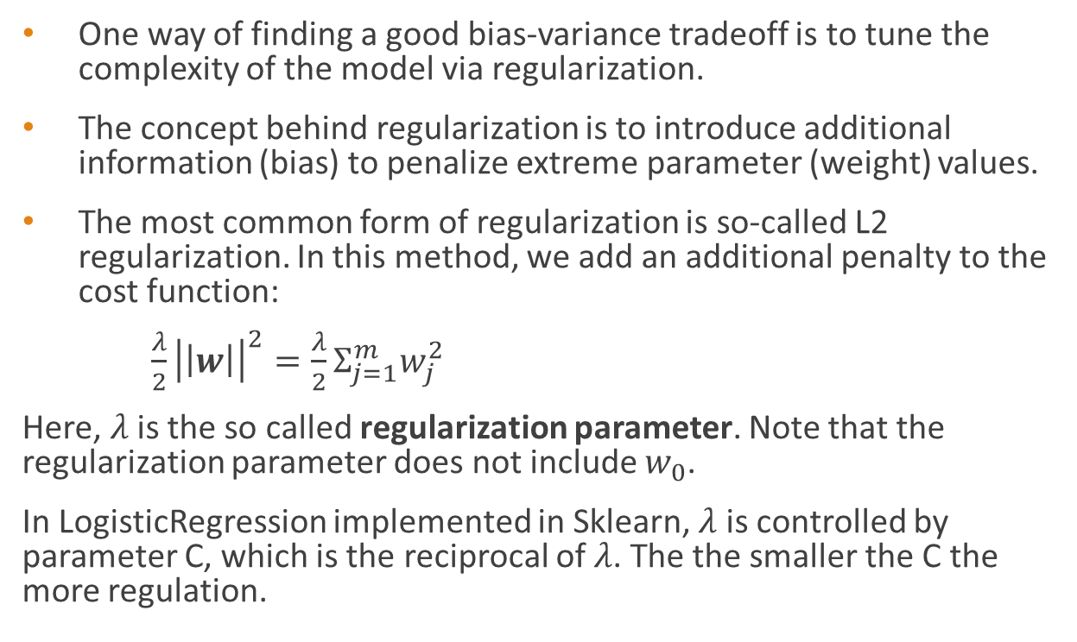
Tackling overfitting via regularization
One way of finding a good bias-variance tradeoff is to tune the complexity of the model via regularization.
The concept behind regularization is to introduce additional information (bias) to penalize extreme parameter (weight) values.
The most common form of regularization is so-called L2 regularization. In this method, we add an additional penalty to the cost function:
$\frac{λ}{2}{\left|\left|w\right|\right|}^{2}=\frac{λ}{2}Σ_{j=1}^{m}w_{j}^{2}$
Here, $λ$ is the so called regularization parameter. Note that the regularization parameter does not include $w_{0}$.
In LogisticRegression implemented in Sklearn, $λ$ is controlled by parameter C, which is the reciprocal of $λ$. The the smaller the C the more regulation.

